Slide 1
Applications of the course
Lecture 37 – Lecture 39

Slide 2
Applications of the course
Speech synthesis
Convolution neural networks
Health applications
Optics and Spatial filtering
And some more

Slide 3
Applications of the course
Speech synthesis
Convolution neural networks
Health applications
Optics and Spatial filtering
And some more

Slide 4
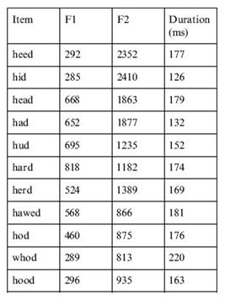
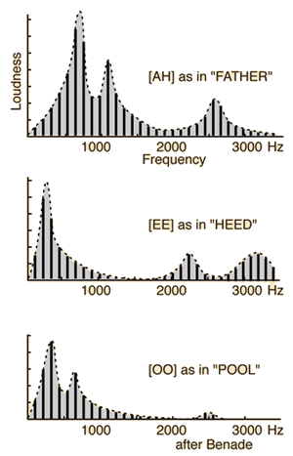
Fourier Series of Vowels

Slide 5
Mapping CT system to DT system

Slide 6
CT and DT system
Basic CT system
Basic DT system
A
p
p_{o}
D

Slide 7
CT and DT system
Basic CT system
Basic DT system
A
p
p_{o}
D

Slide 8
Forward Euler
T
A
y[n]
y[n+1]

Slide 9
Forward Euler
T
A
y[n]
y[n+1]

Slide 10
Forward Euler
T
A
y[n]
y[n+1]

Slide 11
Forward Euler
T
A
y[n]
y[n+1]

Slide 12
Forward Euler
jω
s-plane
z-plane
r=1

Slide 13
Forward Euler
jω
s-plane
z-plane
r=1

Slide 14
Forward Euler
jω
×
s-plane
z-plane
×
r=1
×
×

Slide 15
Backward Euler
T
A
y[n-1]
y[n]

Slide 16
Backward Euler
T
A
y[n-1]
y[n]

Slide 17
Backward Euler
jω
s-plane
z-plane
r=1

Slide 18
Backward Euler
jω
×
s-plane
z-plane
r=1
×
×
×

Slide 19
Trapezoidal
T
A
y[n-1]
y[n]

Slide 20
Trapezoidal
T
A
y[n-1]
y[n]

Slide 21
Trapezoidal
jω
s-plane
z-plane
r=1

Slide 22
Impulse-invariance
Basic CT system
Basic DT system
A
p
e^{p}
D

Slide 23
Applications of the course
Speech synthesis
Convolution neural networks
Health applications
Optics and Spatial filtering
And some more

Slide 24
Teach intelligence to Computers

Slide 25
Teach intelligence to Computers
1
-1
-1
1
-1
1
1
-1

Slide 26
Teach intelligence to Computers
1
-1
1
-1
-1
1
-1
1
+ + + = 0
-1
1
-1
1
1
-1
1
-1
+ + + = 0

Slide 27
Teach intelligence to Computers
1
-1
+
-
1
-1
-1
1
-1
1
-
+
+ - - + = 4
-1
1
+
-
-1
1
1
-1
1
-1
-
+
+ - - + = -4

Slide 28
Teach intelligence to Computers
+
-
-
+
1
-1
1
-1
1
-1
1
-1
1
-
+
+
-

Slide 29
Teach intelligence to Computers
+
-
-
+
1
-1
1
-1
1
-1
1
-1
1
-
+
+
-

Slide 30
Teach intelligence to Computers
+
-
-
+
+ -
- +
1
-1
1
-1
1
-1
1
-1
1
-
+
+
-

Slide 31
Teach intelligence to Computers
+
-
4
-
+
+ -
- +
1
-1
1
-1
1
-1
1
-1
1
-
+
+
-

Slide 32
Teach intelligence to Computers
+
-
4
-
+
+ -
- +
1
-1
1
-1
1
-1
1
-1
1
-
+
+
-

Slide 33
Teach intelligence to Computers
+
-
4
-
+
1
+ -
- +
-1
1
-1
1
-1
1
-1
1
-
+
+
-

Slide 34
Teach intelligence to Computers
+
-
4
-4
-
+
1
+ -
- +
-1
1
-1
1
-1
1
-1
1
-
+
+
-

Slide 35
Teach intelligence to Computers
+
-
4
-4
-
+
1
-1
1
-1
1
-1
+ -
- +
1
-1
1
-
+
+
-

Slide 36
Teach intelligence to Computers
+
-
4
-4
-
+
-4
1
-1
1
-1
1
-1
+ -
- +
1
-1
1
-
+
+
-

Slide 37
Teach intelligence to Computers
+
-
4
-4
-
+
-4
1
-1
1
-1
1
-1
+ -
- +
1
-1
1
-
+
+
-

Slide 38
Teach intelligence to Computers
+
-
4
-4
-
+
-4
4
1
-1
1
-1
1
-1
+ -
- +
1
-1
1
-
+
+
-

Slide 39
Teach intelligence to Computers
+
-
4
-4
-
+
-4
4
1
-1
1
-1
1
-1
1
-1
1
-4
4
-
+
4
-4
+
-

Slide 40
Teach intelligence to Computers
+
-
4
-4
-
+
-4
4
1
-1
1
-1
1
-1
Convolution layer + Pooling layer
1
-1
1
-4
4
-
+
4
-4
+
-

Slide 41
Applications of the course
Speech synthesis
Convolution neural networks
Health applications
Optics and Spatial filtering
And some more

Slide 42
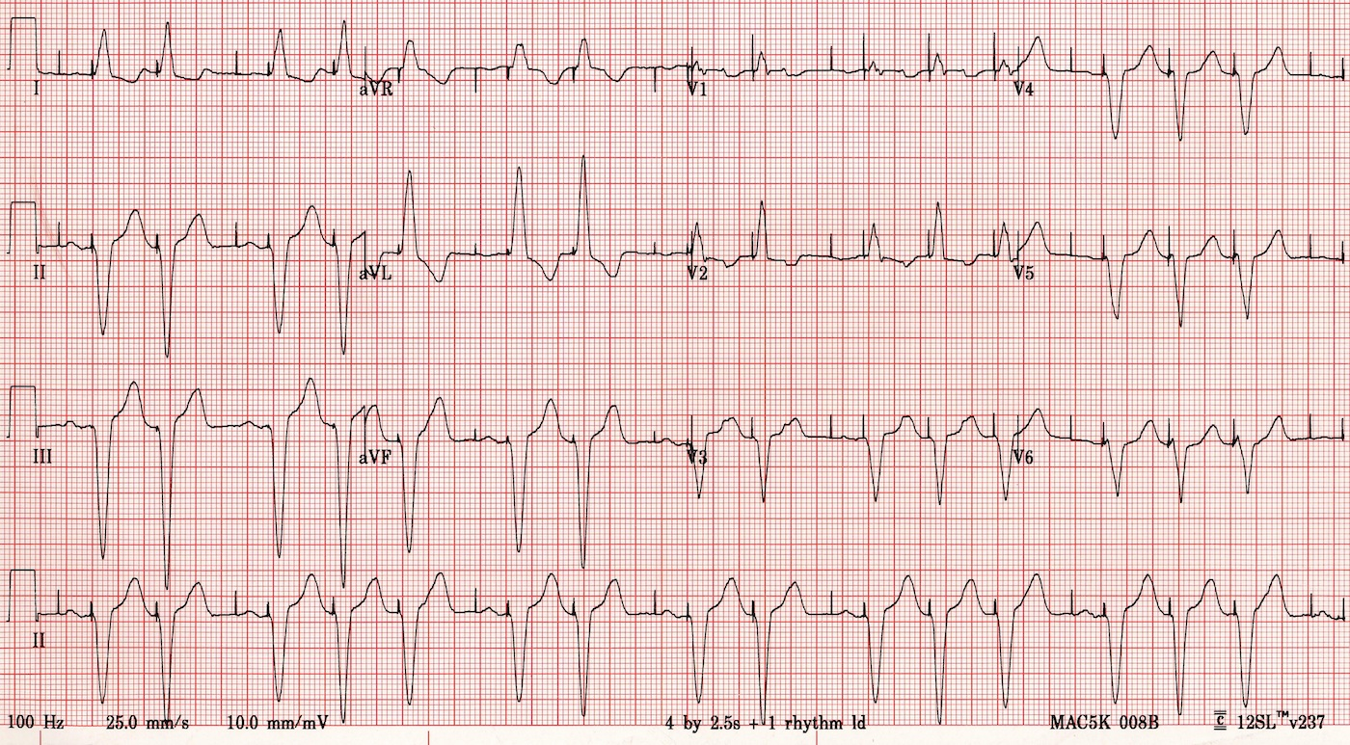
Electrocardiogram

Slide 43
Electrocardiogram
Cells produce 10 mV.
Difficult to get cell voltage because of muscles, etc.
Several sources of noise:
Neurons chatter, AC coupling, etc.

Slide 44
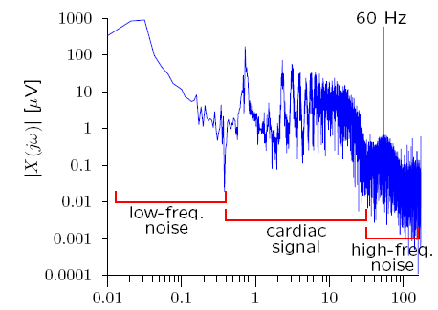
Electrocardiogram
50
x(t) [mV]
2
1
0
t [s]
10 20 30 40 50 60

Slide 45
Electrocardiogram
50
x(t) [mV]
2
1
0
t [s]
10 20 30 40 50 60

Slide 46
How to design filter?
$$\left|H\left(ω\right)\right|$$
0.1 Hz
1 Hz
50 Hz
100 Hz
$$ω$$
Heart beats from 30 to 240 beats per minutes $≈$ 0.5 to 4 Hz

Slide 47
How to design filter?
$$\left|H\left(ω\right)\right|$$
ROI
0.1 Hz
1 Hz
50 Hz
100 Hz
$$ω$$
Heart beats from 30 to 240 beats per minutes $≈$ 0.5 to 4 Hz

Slide 48
Pole zero plot and frequency response
A single zero
High frequency asymptote
$$20\log\left|H\left(ω\right)\right|$$
$$H\left(ω\right)=jω+a$$
$$\left|H\left(ω\right)\right|=\sqrt{ω^{2}+a^{2} }=\left\{\begin{aligned}ω ω≫a \\ a ω≪a\end{aligned}\right.$$
Low frequency asymptote
$$20\log\left|H\left(ω\right)\right|=\left\{\begin{aligned}20\log{ω} ω≫a \\ 20\log{a} ω≪a\end{aligned}\right.$$
$$\log\left|a\right|$$
$$\log\left|ω \right|$$

Slide 49
Pole zero plot and frequency response
A single zero
$$20\log\left|H\left(ω\right)\right|$$
20 dB/decade
$$H\left(ω\right)=jω+a$$
$$\left|H\left(ω\right)\right|=\sqrt{ω^{2}+a^{2} }=\left\{\begin{aligned}ω ω≫a \\ a ω≪a\end{aligned}\right.$$
$$20\log\left|a\right|$$
$$20\log\left|H\left(ω\right)\right|=\left\{\begin{aligned}20\log{ω} ω≫a \\ 20\log{a} ω≪a\end{aligned}\right.$$
$$\log\left|a\right|$$
$$\log\left|ω \right|$$
Bode plot

Slide 50
Pole zero plot and frequency response
40 dB/decade
Two zeros
$$20\log\left|H\left(ω\right)\right|$$
$$H\left(ω\right)=\left(jω+a \right)\left(jω+\text{b} \right)$$
20 dB/decade
$$\left|H\left(ω\right)\right|=\sqrt{ω^{2}+a^{2} }\sqrt{ω^{2}+b^{2} }$$
$$20\log\left|ab\right|$$
$$\log\left|a\right|$$
$$\log\left|b\right|$$
$$\log\left|ω \right|$$
Bode plot

Slide 51
Pole zero plot and frequency response
A single pole
$$H\left(ω\right)=\frac{1}{jω+a }$$
$$20\log\left|H\left(ω\right)\right|$$
$$20\log\left|a\right|$$
$$20\log\left|H\left(ω\right)\right|=\left\{\begin{aligned}−20\log{ω} ω≫a \\ −20\log{a} ω≪a\end{aligned}\right.$$
$$\log\left|a\right|$$
$$\log\left|ω \right|$$

Slide 52
Pole zero plot and frequency response
×
$$\left|H\left(ω\right)\right|$$
ROI
×
×
$$2$$
$$2$$
$$2$$
0.1 Hz
1 Hz
50 Hz
100 Hz
$$ω$$
×

Slide 53
Applications of the course
Speech synthesis
Convolution neural networks
Health applications
Optics and Spatial filtering
And some more

Slide 54
Applications of the course
Speech synthesis
Convolution neural networks
Health applications
Optics and Spatial filtering
And some more

Slide 55
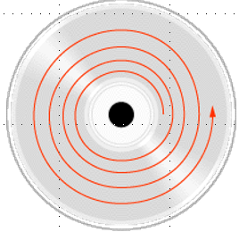
Data track spacing?
μ ?

Slide 56
Young’s double slit experiment
a→0
θ
d
90^{օ}
θ
90^{օ} - θ

Slide 57
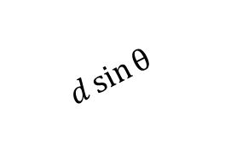
Young’s double slit experiment
θ
d
90^{օ}
$$d\sin{θ }$$

Slide 58
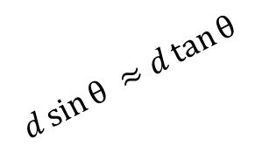
Young’s double slit experiment
θ
d
z
90^{օ}
$$d\sin{θ ≈d\tan{θ}}$$
z very large (such that )

Slide 59
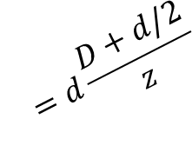
Young’s double slit experiment
D
θ
d
$$=d\frac{D+d/2}{z}$$
z
90^{օ}
$$d\sin{θ ≈d\tan{θ}}$$

Slide 60
Young’s double slit experiment

Slide 61
CD track length

Slide 62
Diffraction (Fraunhofer)
x
θ
z

Slide 63
Diffraction (Fraunhofer)
x
θ
z

Slide 64
Diffraction (Fraunhofer)

Slide 65
Diffraction (Fraunhofer)
d

Slide 66
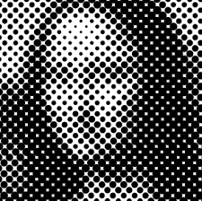
Halftone dots noise
Optical Low pass filter

Slide 67
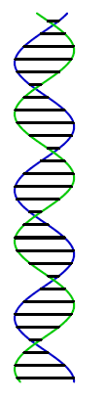
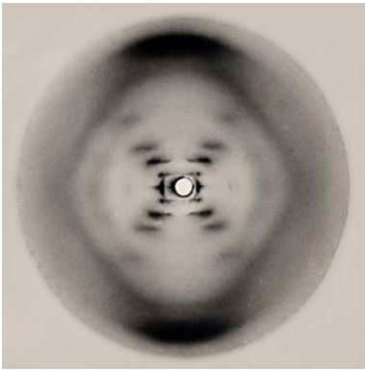
Rosalind Franklin Image of
double helix

Slide 68
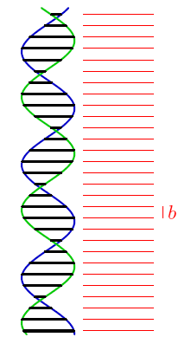
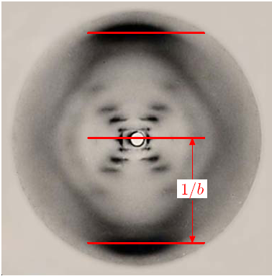
Rosalind Franklin Image of double helix

Slide 69
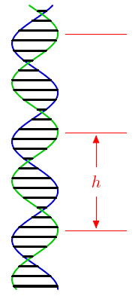
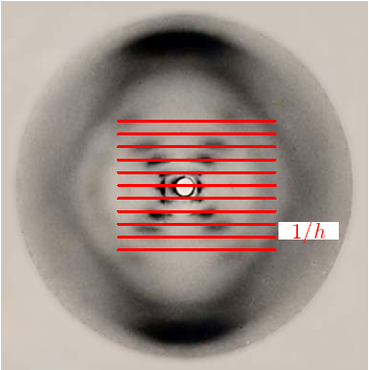
Rosalind Franklin Image of double helix

Slide 70
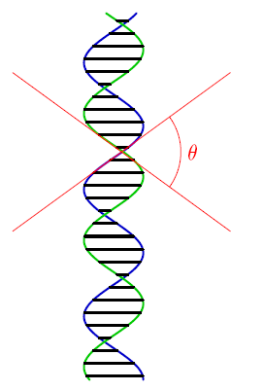
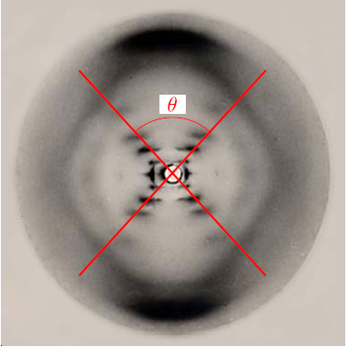
Rosalind Franklin Image of double helix

